Slide 1

Desktop Greenhouse Innovation
Peyton Lettau | Sebastian Hondl
John Robinson | Will McConnell
Notes:
Morning everyone. Today I'm presenting on our progress towards a mechanism for desktop greenhouses.

Slide 2
How do we scale down greenhouse technology from large scale operations to the desktop size?
6 Bar
provide complete access to plants
improve function over other desktop greenhouses
Notes:
This project addresses the question of how do we scale down greenhouse technology from large scale operations to the desktop size?
Our solution attempts to use a 6 bar linkage to provide complete access to plants and improve function over other desktop greenhouse systems.

Slide 3

Greenhouse Primary Functions
Encourage Plant Growth Via:
Temperature Control
Moisture/Humidity Control
Short-wave light transmission
Notes:
Greenhouses work by doing 3 things, controlling temperature, humidity, and allowing light in.
The right balance of these 3 parts, create the ideal plant growth environment year-round.

Slide 4
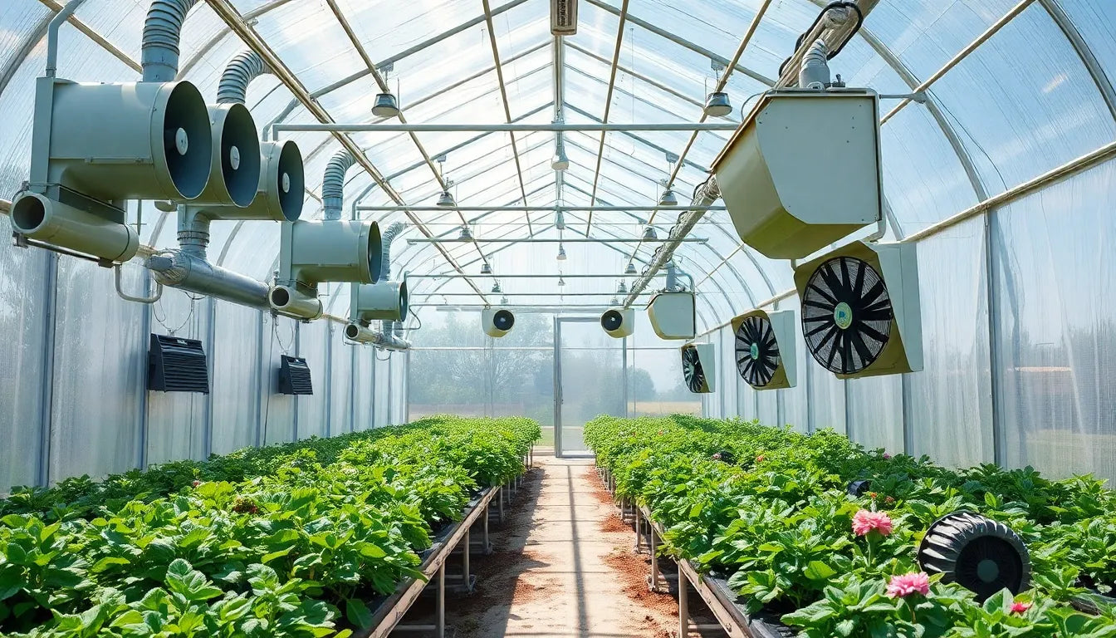
Notes:
At the industrial scale, this is accomplished by using large structures, fans, heaters, humidifiers, and a lot of sensors. At the desktop scale, we simply do not have the room nor the budget to integrate these features.
Without the large spaces, we also are limited on access to the plants.
This is where our project comes in.
We need to design new mechanisms for small scale applications that address access and function on a budget.

Slide 5
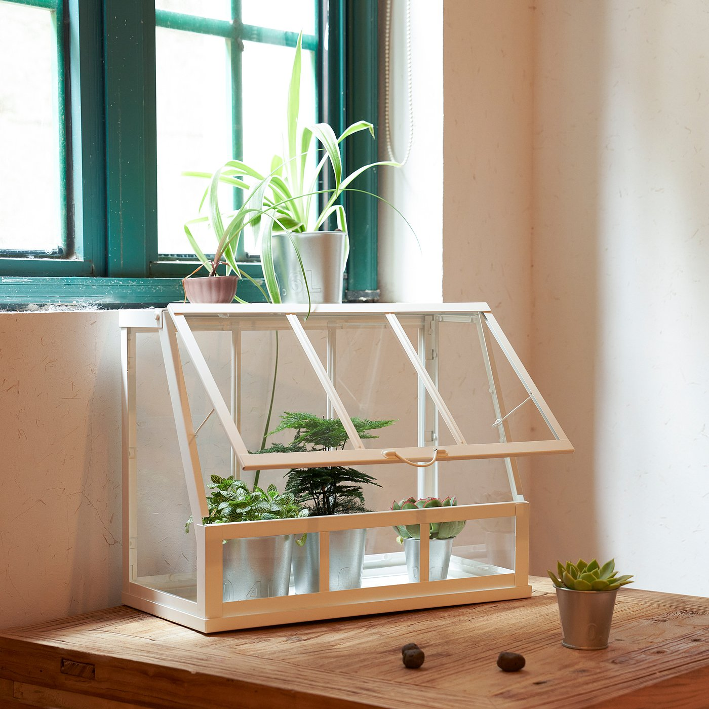
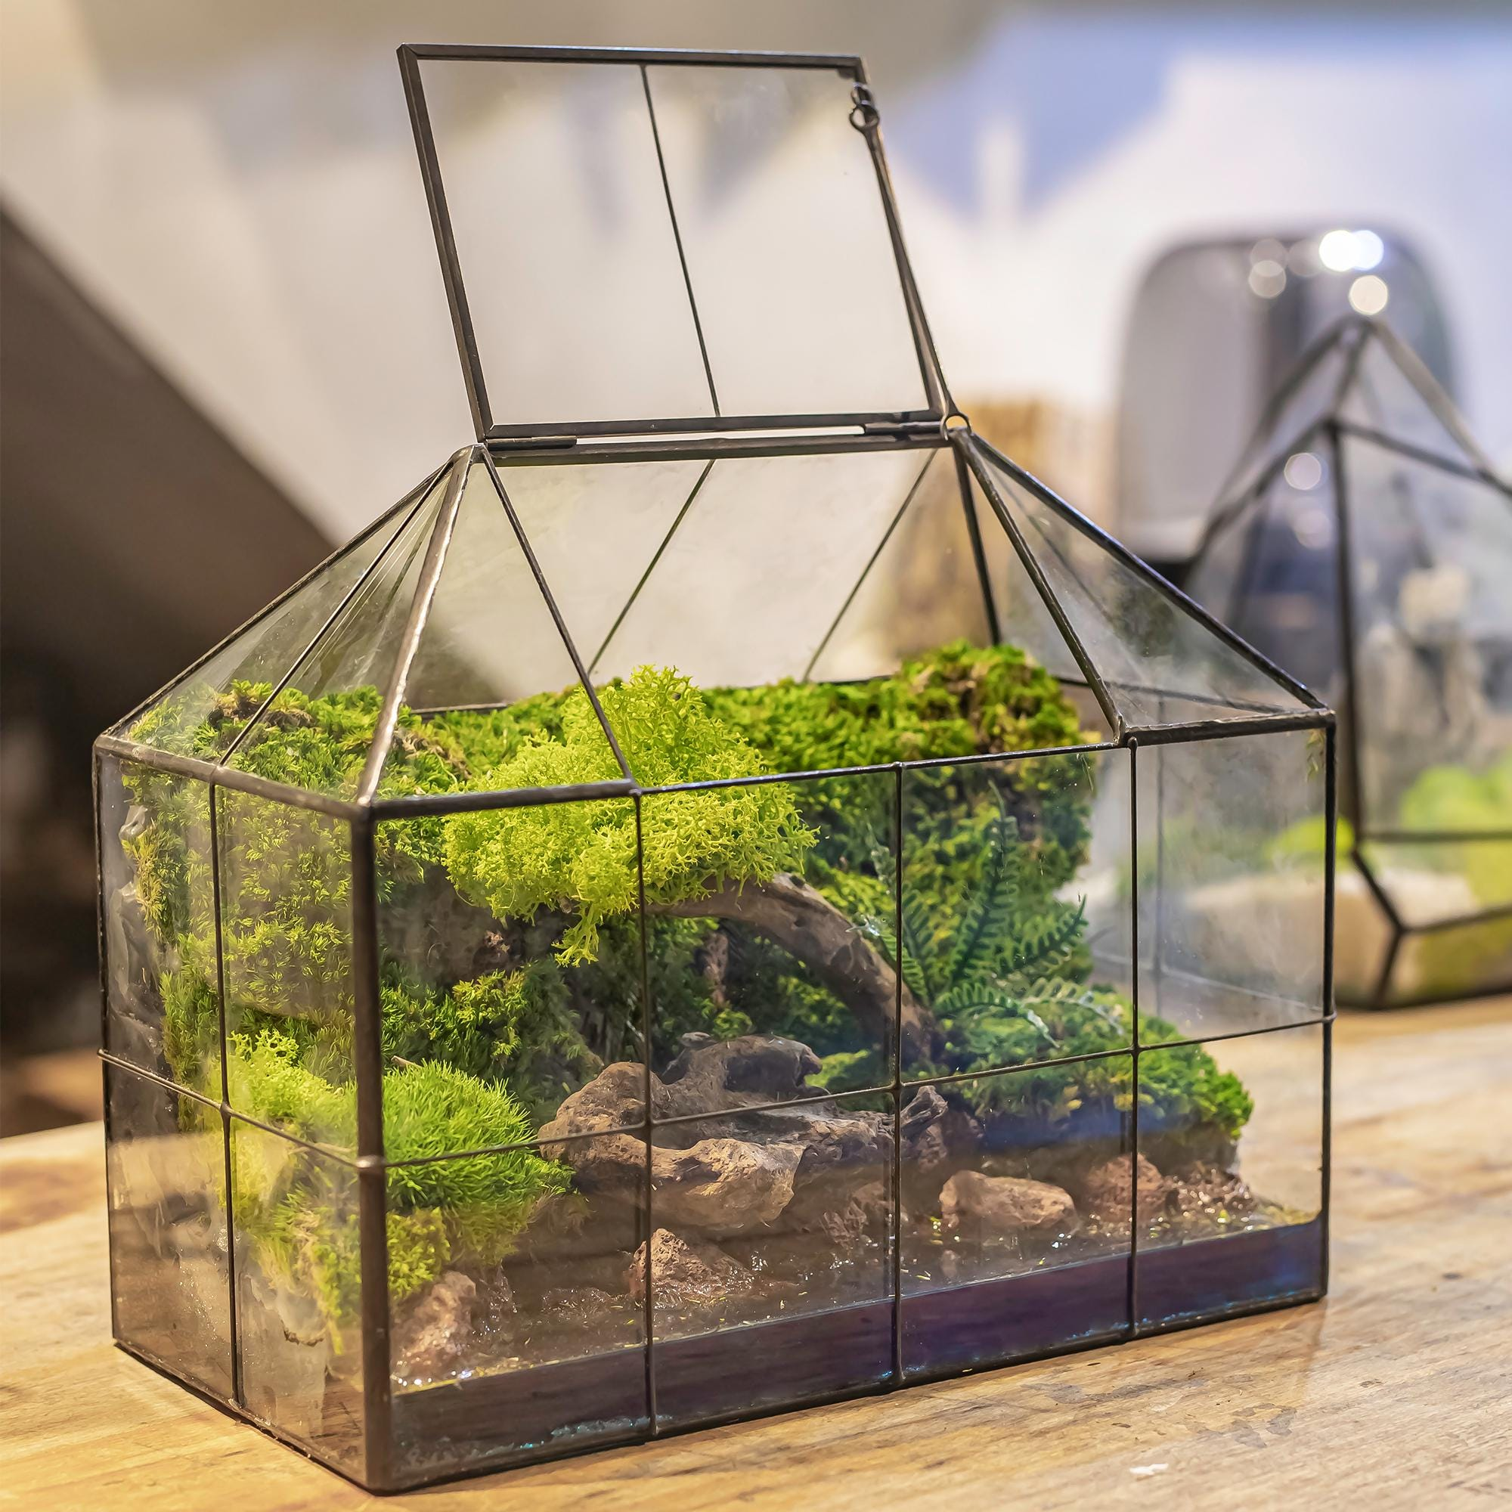
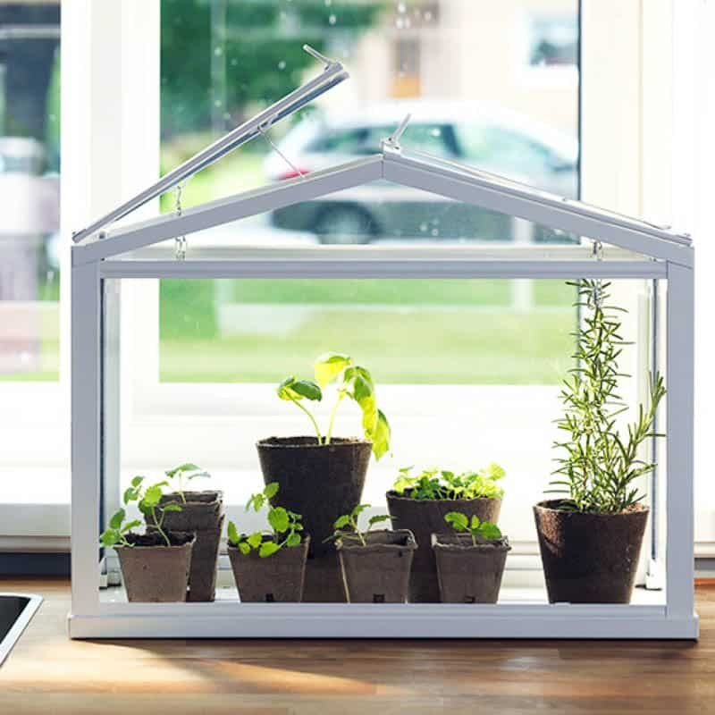
Notes:
Existing desktop solutions range in size and design.
Some open at the top and some at the front, some can partially open and some only fully open for ventilation,
but all examples lack access and adjustability that comes with large scale greenhouses. Our design addresses both of these factors.

Slide 6
Front
Top
Top
Notes:
Existing desktop solutions range in size and design. Some open at the top and some at the front, some can partially open and some only fully open for ventilation, but all all examples lack access and adjustability that comes with large scale greenhouses. Our design addresses both of these factors.

Slide 7
Front
Partial
Top
Full
Top
Partial
Notes:
Existing desktop solutions range in size and design. Some open at the top and some at the front, some can partially open and some only fully open for ventilation,
but all examples lack the access and adjustability that comes with large scale greenhouses. Our design will address both of these factors.

Slide 8
Goal Statement
Design and build a compact mechanism that opens and closes a desktop greenhouse whose sides are constrained by adjacent walls. The mechanism shall articulate the top and front panels to provide full, unobstructed plant access and offer stable, adjustable hold-positions along the motion path for customizable ventilation.
Notes:
To do that, we’ve chosen this goals statement:
Design and build a compact mechanism that opens and closes a tabletop greenhouse whose sides are constrained by adjacent walls. The mechanism shall articulate the top and front panels to provide full, unobstructed plant access and offer stable, adjustable hold-positions along the motion path for customizable ventilation.

Slide 9
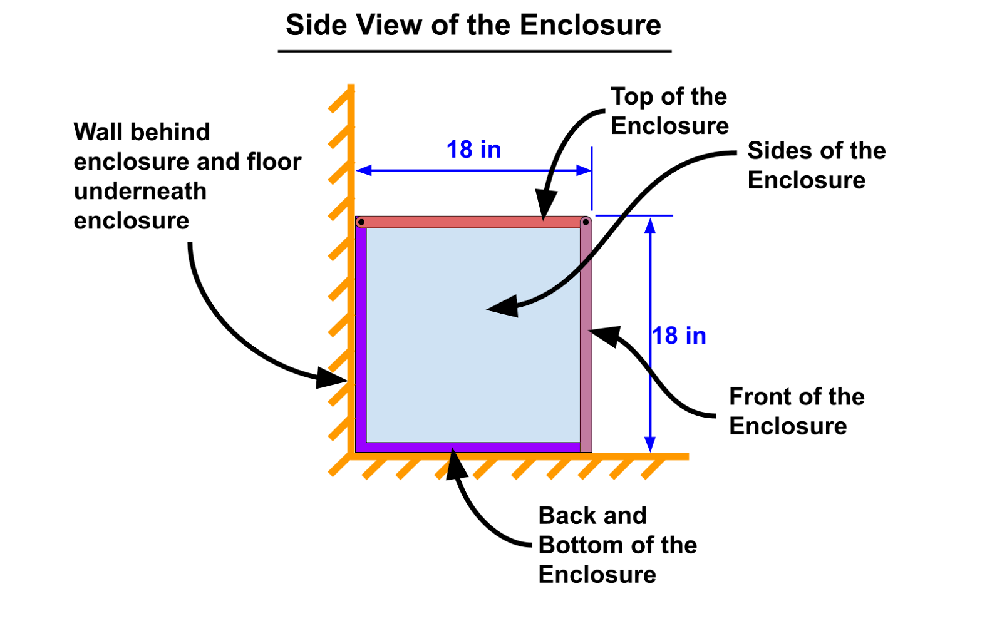
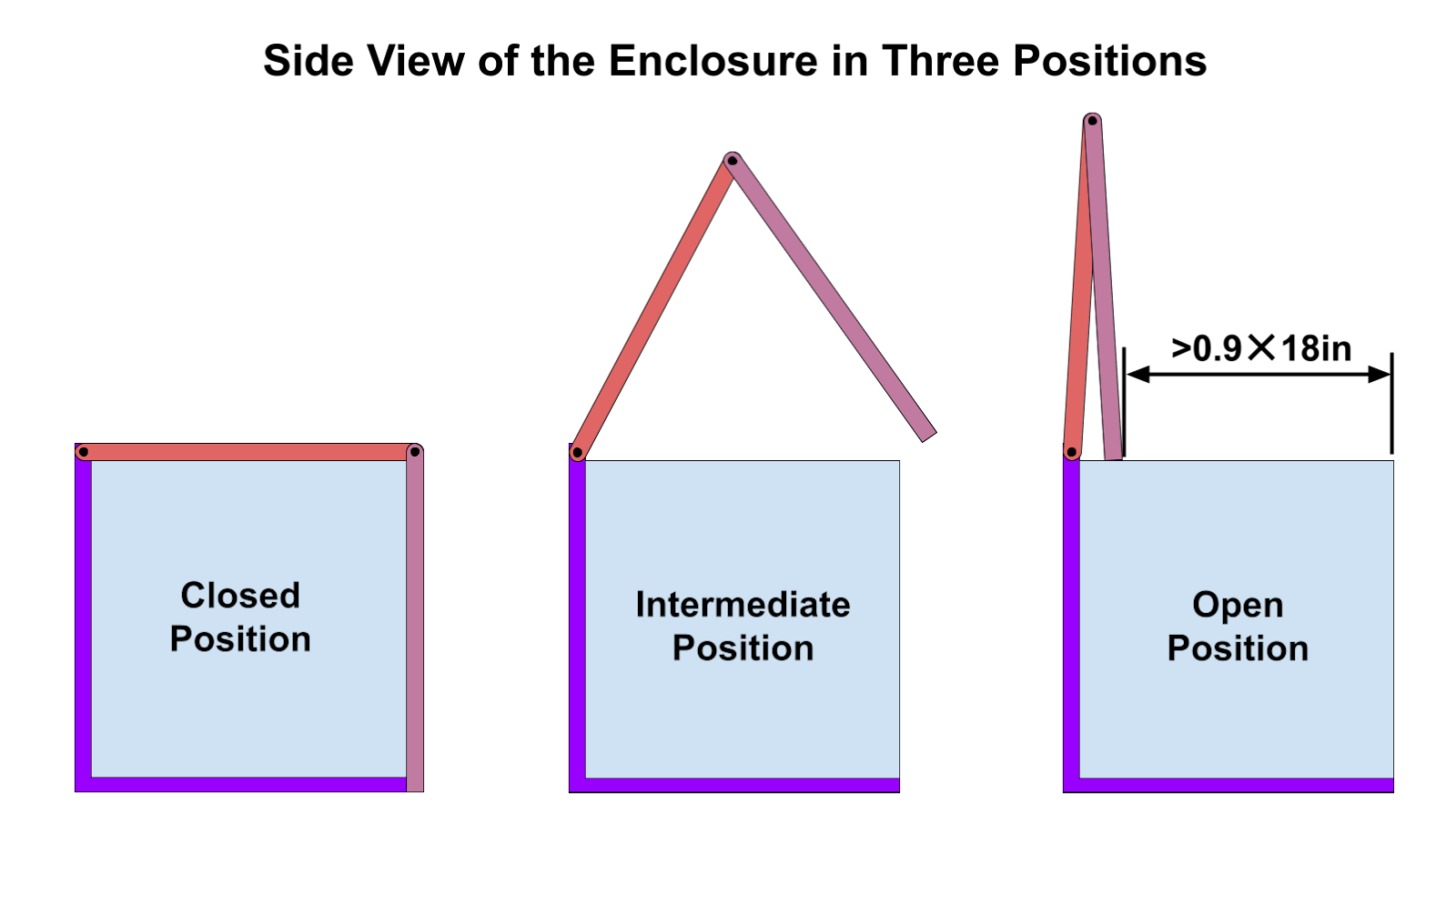
Notes:
As the goal statement requires; there is a wall behind the enclosure. these graphics on the right show an example of our fully open and closed positions, as well as an intermediate position that we may choose for ventilation.

Slide 10
Project Specifications
Provide smooth, controlled motion for fragile glass panels (1/8” thick)
Enable access to plants from both top and front faces simultaneously
Operate within compact tabletop dimensions (approximately 18” tall × 18”deep × 24” wide)
Incorporate spring balancing to reduce actuation forces and prevent impact damage
The opening above the enclosure must be >90% of the depth of the enclosure
Mechanism must not extend beyond the greenhouse silhouette when closed
Compatible with placement against a wall
Minimize interference with internal plant growth space
Allow front and top of the enclosure to be positioned at any position between open and close and remain in place
Fold the top and front panels above the enclosure, creating unobstructed access for plant maintenance
Optimize linkage geometry to provide smooth velocity profiles while maintaining mechanical advantage throughout the operating range
Support the weight of the front and top of the enclosure ( ~ 5lb each)
Notes:
Here’s a detail list of our project specifications. The ones most important to today are:
enable access to plants from both top and front faces simultaneously
The opening above the enclosure must be 90% of the depth of the enclosure
The mechanism must not extend beyond the greenhouse silhouette when closed
must be compatible with placement against a wall
and minimize the interference with internal plant growth space

Slide 11
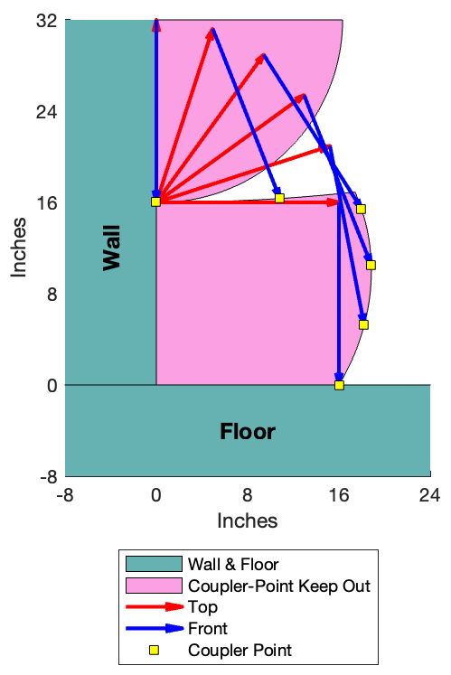
Path Generation
Notes:
For this mechanism, we chose to work with the motion generation task, as we believe, controlling the position of the coupler point along the front face, will drive the best control outcomes. This figure shows the regions where a coupler point can and cannot travel through to satisfy our primary design criteria, assuming the coupler point is placed at the bottom of the front face.

Slide 12
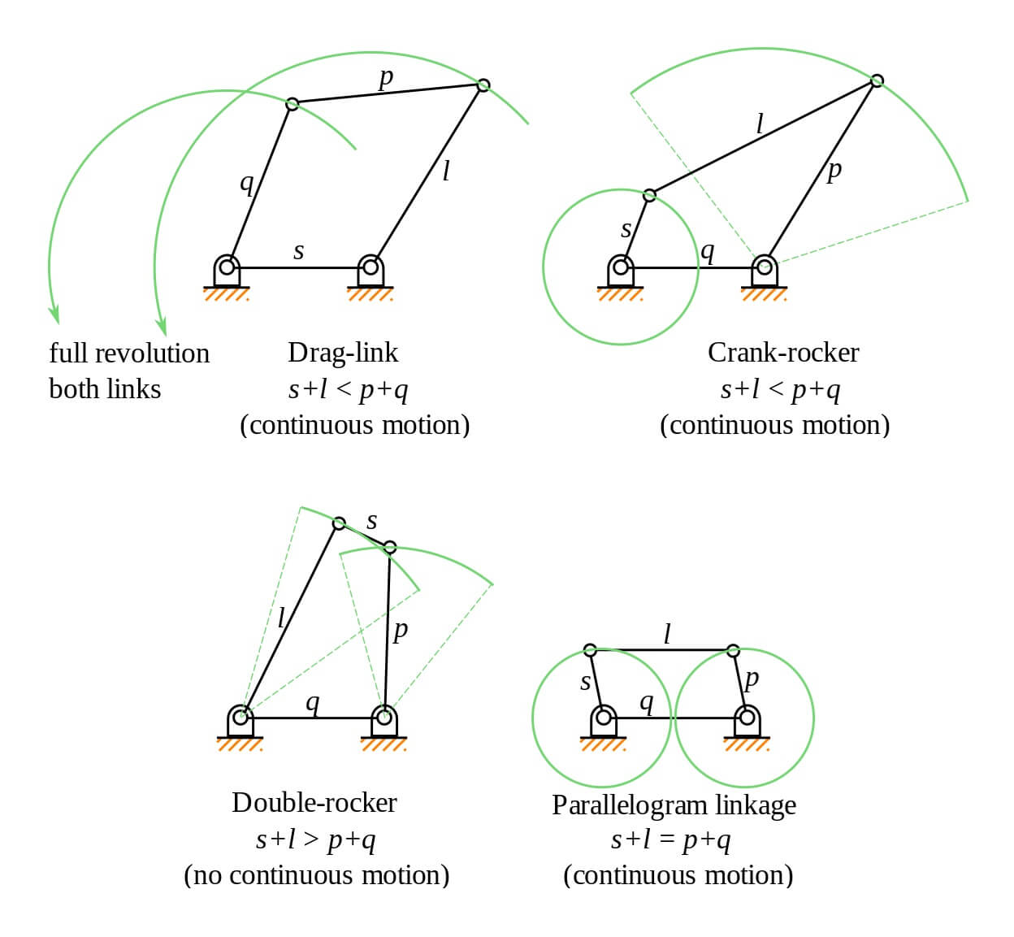
Type Synthesis - 4 Bar
Notes:
We started by quickly evaluating the Grashof 4 bar options and discovered there were no solutions with the complex motion paths and ground pivots within the silhouette.

Slide 13
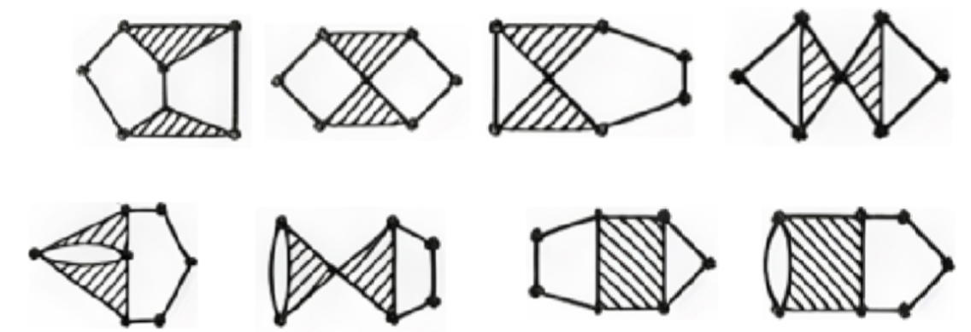
Type Synthesis - 6 Bar
Notes:
So we moved to six bars, starting with our single degree freedom. One degree of freedom means only the Stevenson and Watt chains meet the criteria.

Slide 14
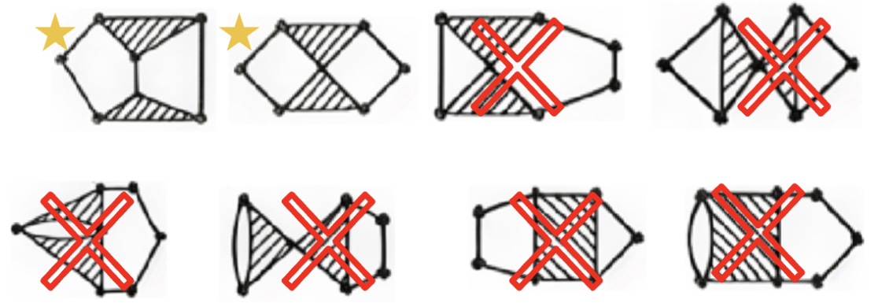
Type Synthesis - 6 Bar
Notes:
So we moved to six bars, starting with our single degree freedom. One degree of freedom means only the Stevenson and Watt chains meet the criteria.

Slide 15
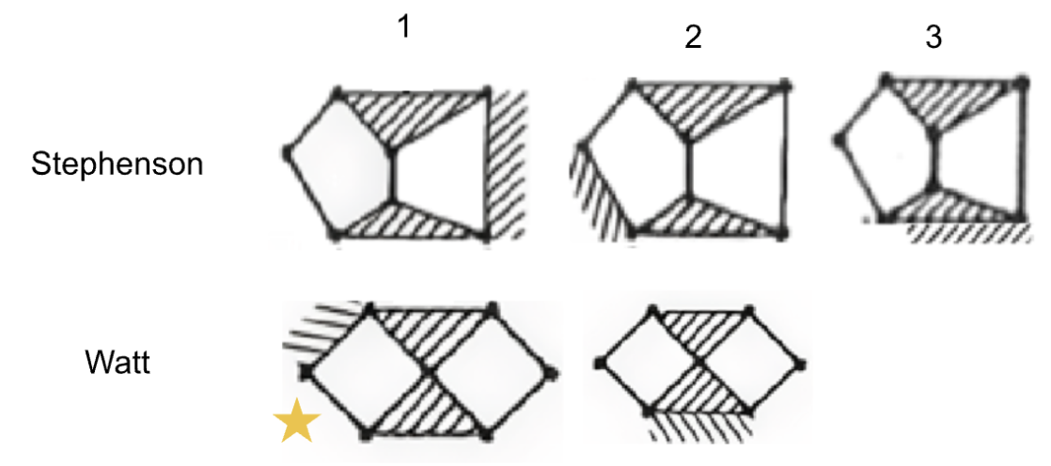
Topological Evaluation
Notes:
We evaluated the topological variations individually, and what we observed was the primary differentiator being ground pivot accessibility.
The Watt 2 and Stevenson 3 require three ground pivots, which cannot be practically accommodated at such a small scale.
The Stevenson 1 and 2 features only 2 ground pivots, but with a disconnected ternary links, longer link lengths will be needed.
For those reasons we settled on the Watt 1 which is promising for a large, complex movements provided by a compact mechanism.

Slide 16
Topological Evaluation
3 ground pivots
3 ground pivots
Notes:
We evaluated the topological variations individually, and what we observed was the primary differentiator being ground pivot accessibility.
The Watt 2 and Stevenson 3 require three ground pivots, which cannot be practically accommodated at such a small scale.
The Stevenson 1 and 2 features only 2 ground pivots, but with a disconnected ternary links, longer link lengths will be needed.
For those reasons we settled on the Watt 1 which is promising for a large, complex movements provided by a compact mechanism.

Slide 17
Topological Evaluation
Disconnected Ternary Links
Disconnected Ternary Links
3 ground pivots
3 ground pivots
Notes:
We evaluated the topological variations individually, and what we observed was the primary differentiator being ground pivot accessibility.
The Watt 2 and Stevenson 3 require three ground pivots, which cannot be practically accommodated at such a small scale.
The Stevenson 1 and 2 features only 2 ground pivots, but with a disconnected ternary links, longer link lengths will be needed.
For those reasons we settled on the Watt 1 which is promising for a large, complex movements provided by a compact mechanism.

Slide 18
Topological Evaluation
Disconnected Ternary Links
Disconnected Ternary Links
3 ground pivots
Compact size with complex motion paths
3 ground pivots
Notes:
We evaluated the topological variations individually, and what we observed was the primary differentiator being ground pivot accessibility.
The Watt 2 and Stevenson 3 require three ground pivots, which cannot be practically accommodated at such a small scale.
The Stevenson 1 and 2 features only 2 ground pivots, but with a disconnected ternary links, longer link lengths will be needed.
For those reasons we settled on the Watt 1 which is promising for a large, complex movements provided by a compact mechanism.

Slide 19
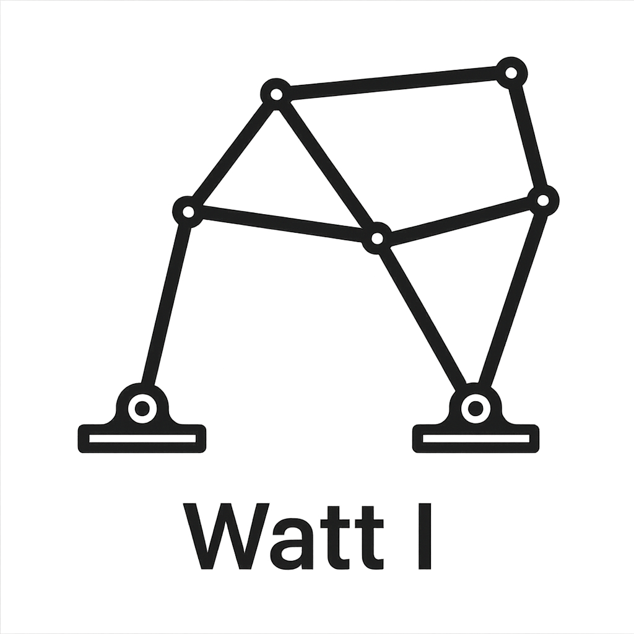
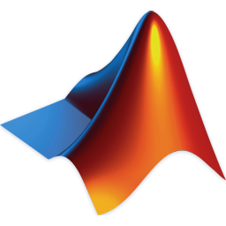
Where We Are Now
Chosen chain to explore: Watt I
Next steps: Develop MatLab program to explore solutions using ground pivot specification.
Notes:
So, our progress has brough us here. We’ve chosen our chain through type synthesis and are beginning to develop a Matlab program to explore solutions using ground pivot specifications. Any questions?

Slide 20
Thank you

